Slide 1
CS210 Discussion
Week 4

Slide 2

Project 2 – Queues Galore
Elementary data structures
Generics
Iterators
Deque
Double ended queue
Randomized queue

Slide 3
Pointers/references in Java
Doesn’t have explicit pointer data types like in C
Object variables are essentially pointers
You can treat them like values/objects being passed around
But they are just references to data on the heap
Object x = new Object(“Hello World”);
Object
X
Object@4d55dh2w

Slide 4
Generics
Placeholder types
Allows you to define classes/methods that operate on any type

Slide 5
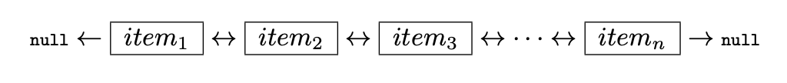
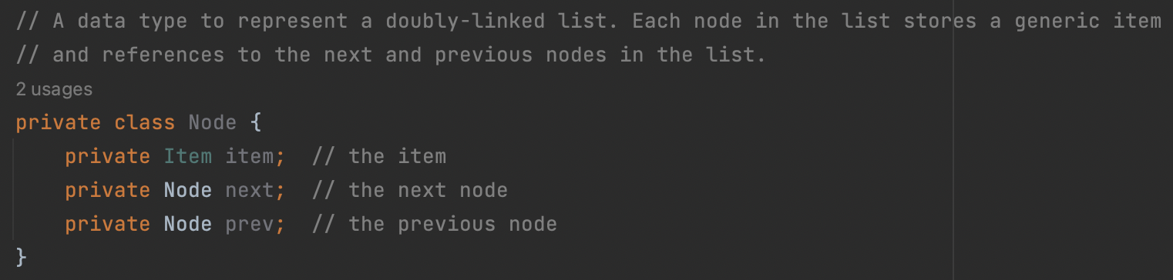
Doubly Linked List
First
Last
← “Pointers”
Which item does ‘next’ point to?
What about ‘prev’?

Slide 6
Doubly Linked List
First
Last
// Create item 1
Node item1 = new Node();
// Create item 2
Node item2 = new Node();
item1.next = item2;
item2.prev = item1;
// Create item 3
Node item3 = new Node();
item2.next = item3;
item3.prev = item2;

Slide 7
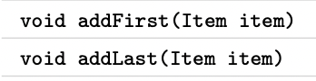
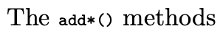
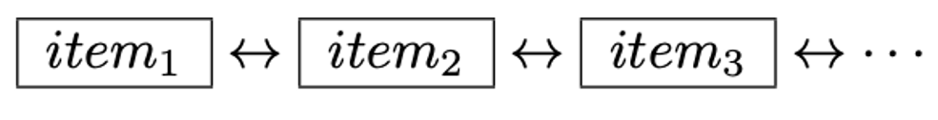
Deque - Double ended queue
P1
Uses a doubly linked list as the underlying data structure
Like a normal queue but with more methods
Peek vs remove
Get the item
Get and remove the item
first

Slide 8
Deque - Double ended queue
P1
Return an object that ‘implements’ the Iterator interface
This isn’t the same as the objects type
But we can treat it similarly
An interface
Defines specific functions a class MUST implement
Can be used in place of the class name itself

Slide 9
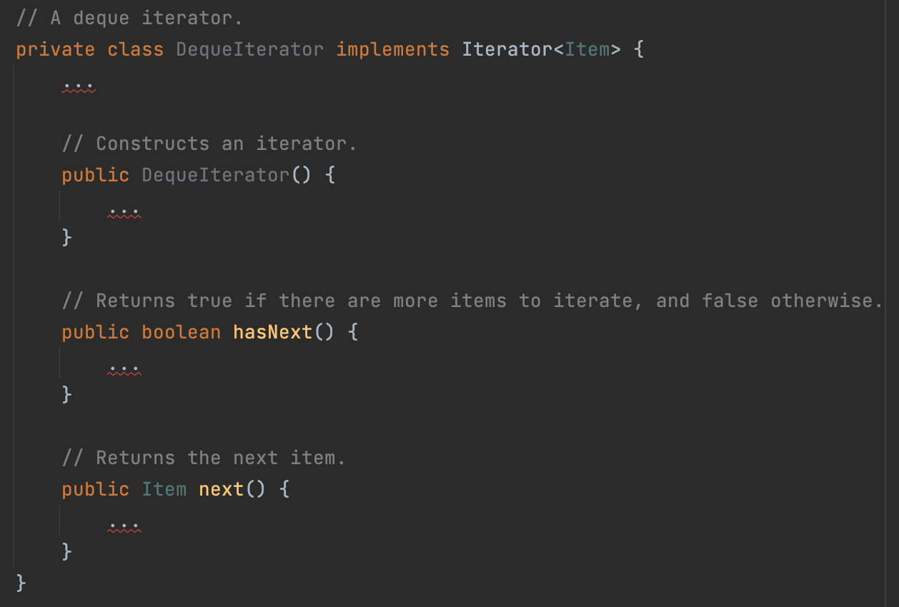
Deque - Double ended queue
P1

Slide 10
Deque - Double ended queue
P1
Performance T(n) ~ 1
For ALL constructors and ALL methods
Input size shouldn’t affect runtime
Size of the deque itself shouldn’t affect runtime

Slide 11

Sorting Strings
P2
Uses the LinkedDeque data structure you built in problem 1
Make sure you compile LinkedDeque
Take strings from StdIn and sort them into the deque
Print the sorted strings out

Slide 12

Questions about the first two problems?

Slide 13
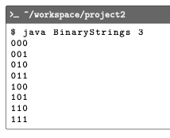
Binary Strings
E1
Binary strings
Strings representing a binary number
For example, “01010”
Iterate over binary strings w/ specified # of digits
Iterators!

Slide 14
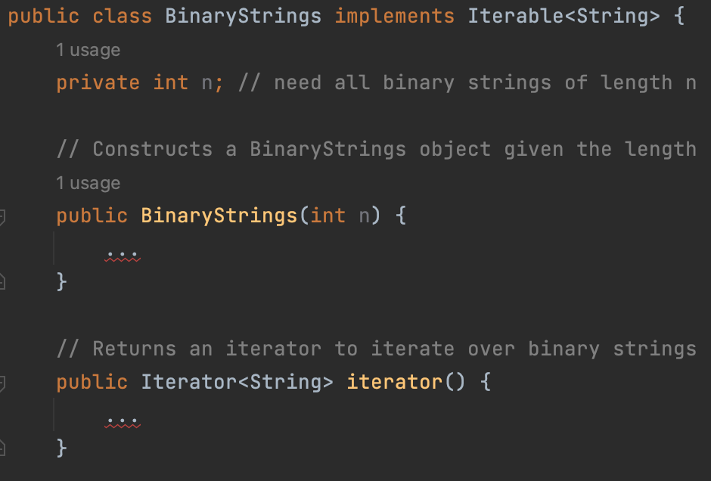
Binary Strings
E1
Simple constructor
Set n
What’s the syntax?
“iterator” returns the iterator inner class

Slide 15
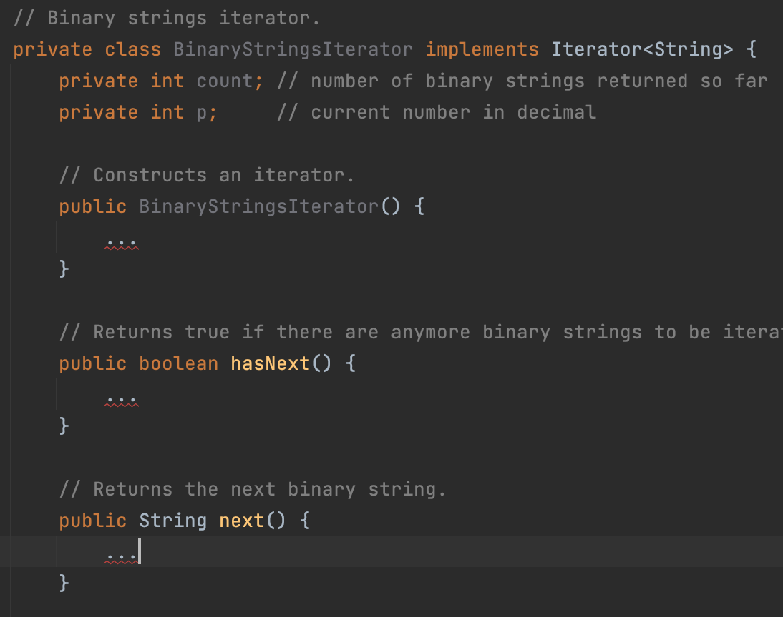
Binary Strings
E1
Iterator inner class
Iterator interface
hasNext
next
Has access to outer class instance variables
n
Method to turn a number into a binary string is done for us.

Slide 16
Binary Strings
E1
Simple constructor
Set count and p to 0
What about hasNext?
True if there are more binary strings
False otherwise
For a binary string with ”n” digits, what’s the largest integer our binary string can represent?
3 digits: “000” = 0, “111” = 7

Slide 17
Binary Strings
E1
next
Gives the binary string representation of p
Use the given “binary” method
Increment p and count by 1
Readying the next binary string

Slide 18
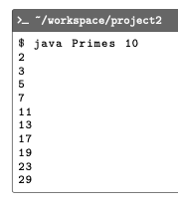
Primes
E2
Like binary strings but you’re iterating over primes
First n primes
In this case, you iterate until you’ve found 10 primes →
isPrime is done for us
Iterating Integers instead of Strings

Slide 19
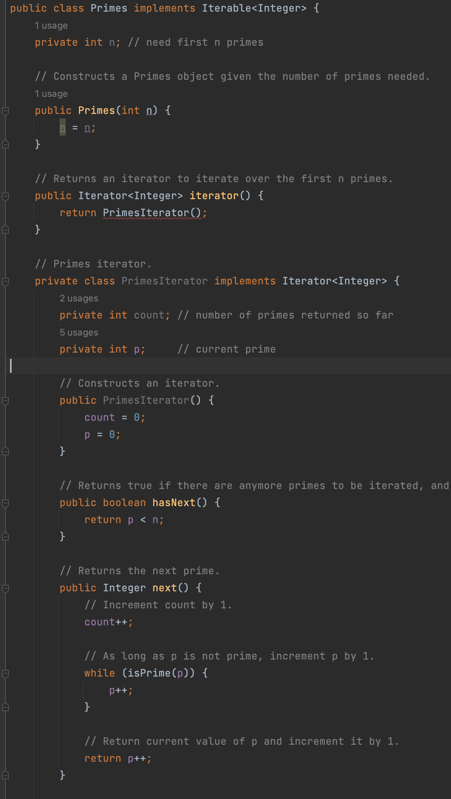
Primes
E2
Debugging my version of primes
Each method has 1 bug
The constructor also has 1 bug
Think about how we did Binary Strings
And how this program might be different

Slide 20
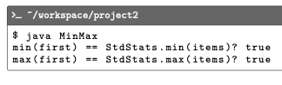
MinMax
E3
Linked lists! Traversal!
Singly linked list
Go through the list and find the smallest and largest items

Slide 21
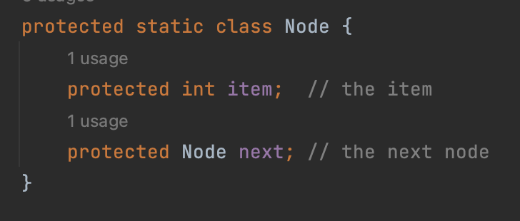
MinMax
E3
These are the nodes in our linked list
Items here are just integers
We have a reference to the first one in the list
The arguments to the functions in MinMax
Then we use the “next” reference to get to the next node in the list

Slide 22
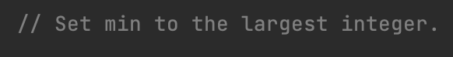
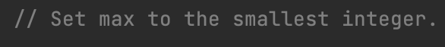
MinMax
E3
This is a bit confusing
Here it doesn’t mean the largest/smallest item in the list, which is what the overall goal is
It’s saying, start our comparison with the largest/smallest integer possible in Java
Integer.MAX_VALUE
Integer.MIN_VALUE

Slide 23
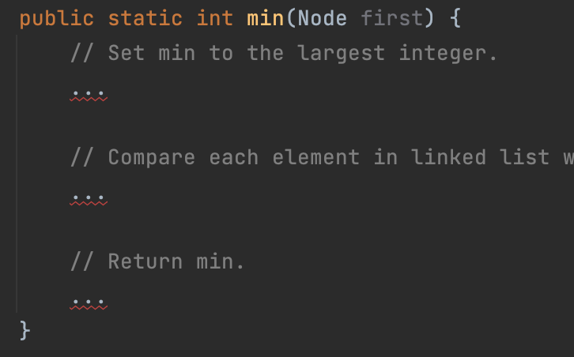
MinMax
E3
Go item by item and keep tabs on what the smallest integer you’ve seen is
Using the next variable of each Node
This will be an odd For loop
After all the items in the linked list, return the smallest integer we saw

Slide 24
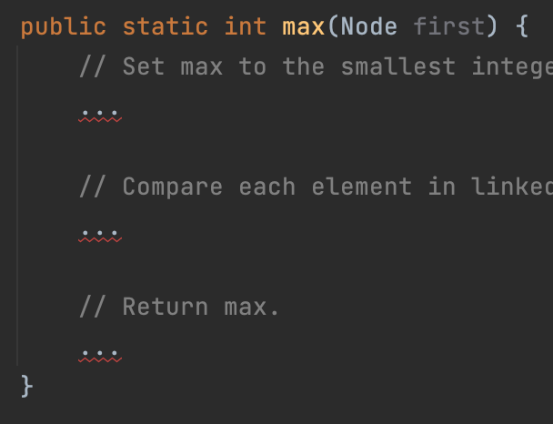
MinMax
E3
Same as ”min” but keep tabs on the largest integer you’ve seen so far
So where in the code will the two functions be different?
Two places
Take a few minutes and write it out “max”
Talk to your neighbor

Slide 25

Questions?

Slide 26
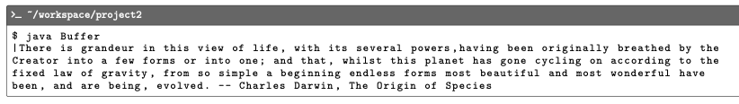
Buffer
E4
The idea here is we’re building a text editor
Buffer – data structure
“cursor”
Methods to move cursor and insert/remove characters
Stacks are the underlying data structure
Two stacks!

Slide 27
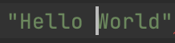
Buffer
E4
Top
Top
“ | H | e | l | l | o
W | o | r | l | d | “
left
right

Slide 28
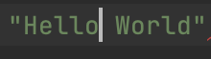
Buffer
E4
Top
Top
“ | H | e | l | l | o
 | W | o | r | l | d | “
left
right

Slide 29
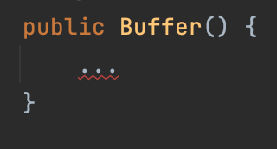
Buffer
E4
Simple constructor
Set instance variables
Left & right stacks
Buffer is empty to start, so nothing in the stacks
How do we create a new empty stack? What would we type for left?

Slide 30
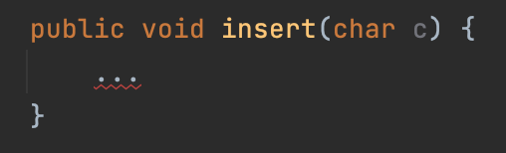
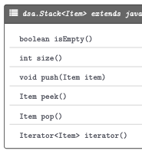
Buffer
E4
When we type, the text shows up to the left of the cursor
Same for “insert”
Left stack
What method do you use to add something on top of a stack?
What would we type to add ”c” to the top of the left stack?

Slide 31
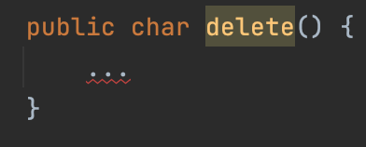
Buffer
E4
Delete, not backspace
Delete the character to the right of the cursor
Right stack
What method do we need to remove the item on top of a stack?
What’s the difference between peek and pop?
What would we type?

Slide 32
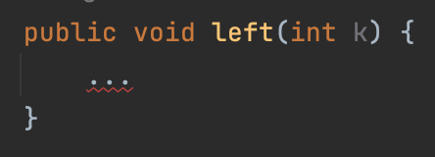
Buffer
E4
How is the cursor represented?
Implicit
Two stacks

Slide 33
Buffer
E4
How is the cursor represented?
Implicit
Two stacks
Moving k characters from one stack to the other
For loop
What stack methods do we use?

Slide 34
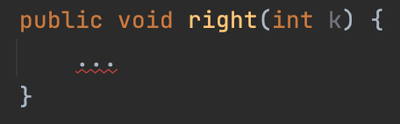
Buffer
E4
Same as left but with one difference
What is it?

Slide 35
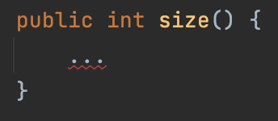
Buffer
E4
The total number of characters in our buffer
Left stack
Right stack
What stack method do we need?
What do we type to get the total buffer size?
Oneliner

Slide 36
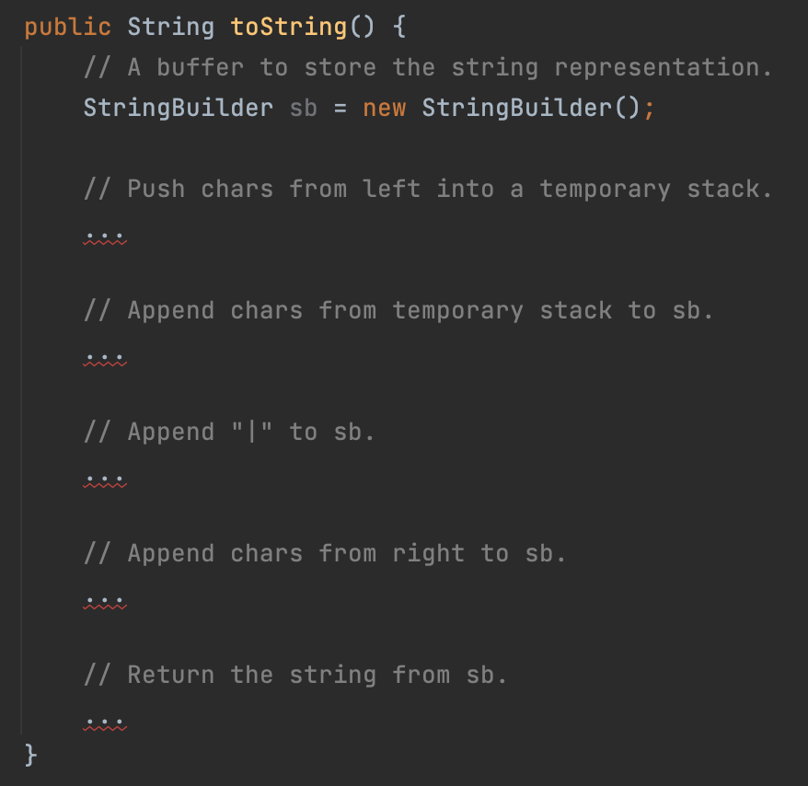
Buffer
E4
The full text of the buffer with the cursor shown as the “|” character
Step by step
Left
Cursor
Right
Why do we use a temporary stack for left?

Slide 37
Buffer
E4
Top
“ | H | e | l | l | o
olleH”
left

Slide 38
Buffer
E4
Top
Top
“ | H | e | l | l | o
“ | H | e | l | l | o
left
temp

Slide 39
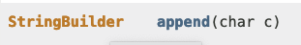
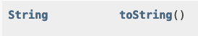
Buffer
E4
Relevant StringBuilder methods
Stacks are iterable so we can use some nice syntactic sugar

Slide 40

Questions?

Slide 41

Random Queue
Uses a resizing array as the underlying data structure
You have to manage the array
”resize” method done for you
Difference from queue
“sample”
Random iterator

Slide 42
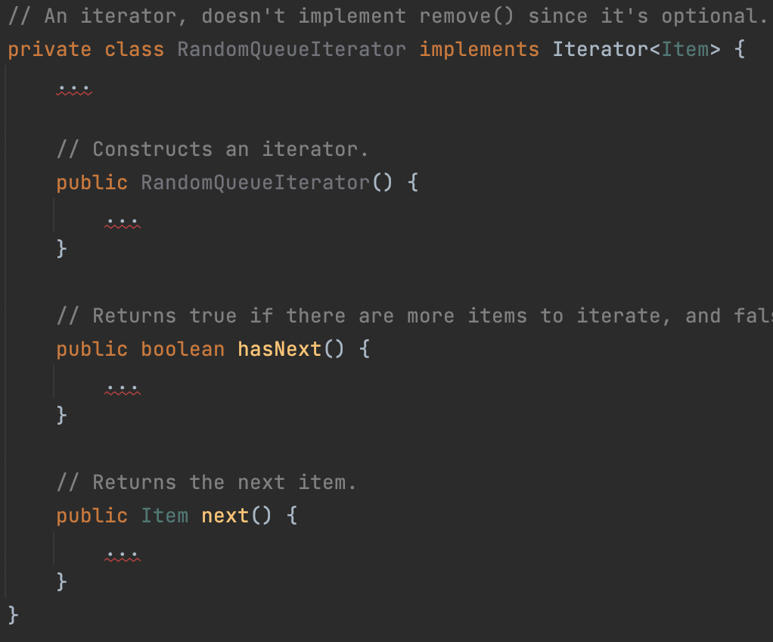
Random Queue
Each iterator should be independent of the original random queue
Maintains it’s own copy of the items in the random queue

Slide 43
Random Queue
All methods in the random queue should run in constant time
All methods in the iterator should run in constant time
Except the constructor, which should run in linear time

